Slide 1

MAP
An Overview
Kinetium Inc.
Notes:
Structure
A little more method overview
Add “Basic Modeling”: objects + actions → info + behavior models (without any diagrams??)
Add fully-worked, tiny case study as posters
Include notation summaries
Main structure should reflect new method documentation

Slide 2
Outline
What is MAp?
MAp – Formal Architecture Framework
  Goal Modeling
  Viewpoints and Concerns – Black Box, White Box, Technical, …
  Architecture Style
MAp – Process Pragmatics
  Iterative and Incremental
  Roadmap Route: Problem Definition, Current State, Target State, Migration Plan
  Flexible Models and Domains
Summary

Slide 3


What is MAP?
MAP – Model-Driven Approach for clear, business-aligned, architectural solutions
MAP is a systematic approach to plan, architect, develop, and evolve software systems
  Clearly separated viewpoints and models to design or analyze an architecture
1. Business Driven
business goals, terminology, process first
relate disparate views
relate multiple systems, programs, initiatives
2. Traceability
bridge Business and IT
precise shared vocabulary
critical business questions early
5. Reuse Process
reuse business models
… and architectures
… and implementations
develop for reuse
develop with reuse
4. Consistent Architecture
blueprint for consistency
principles, patterns, styles
both business and technical
standards for interoperability
3. Design and Assemble Pluggable Components
federated components, services; not monolithic systems
clear interfaces and responsibilities
reusable and maintainable building blocks
Builds upon best practice and industry standards for architecture: UML, EDOC, RM-ODP, Catalysis, Simple Components, RUP, Problem Frames, Goal Modeling

Slide 4


What Questions Does MAp Ask?
What are the properties of the box visible at its boundary?
functionality: services offered and
required, events handled,
information handled
others: volumes, performance,
location, security, tech platform
Why? What is the bigger
goal being achieved outside?
How is our box combined with other parts to solve it?
Are there better approaches?
What is the boundary of the “box”
we are describing?
Workers
Policies
Our Box
Resources
What internal “boxes” can be combined to do the job?
Existing or New boxes?
How to partition behavior and information responsibility to meet end-to-end needs?
What are the properties of each internal box?
functionality: services offered and
required, events handled,
information handled
others: volumes, performance,
location, security, tech platform
What consistent principles, patterns, or styles guide our design and are shared across components?
How should we document all these?

Slide 5
Two Aspects of the MAP Framework
Formal Architecture Framework
Goals
Viewpoints
Concerns
Models
Refinement
Architecture Styles
Process Pragmatics
Routes: Roadmap, Construction, …
Different Entry Points
Iterative and Incremental
List, Draft, or Dressed Templates
Guidelines
Checklists
Architecture always ties back to goals.
Different presentation suitable to audience
Clear and unambiguous architecture
How to prioritize and focus work?
How much detail is appropriate and when?
How to show early value and reduce risk?
How to customize to project needs?

Slide 6
Outline
What is MAp?
Formal Architecture Framework
  Goal Modeling
  Viewpoints and Concerns – Black Box, White Box, Technical, …
  Architecture Style
Process Pragmatics
  Iterative and Incremental
  Roadmap Route: Problem Definition, Current State, Target State, Migration Plan
  Flexible Models and Domains
Summary

Slide 7

Goal is not the same as System Specification
Goal:
laptop → minds
Projector
Specification:
signal → light
Goals are typically 1, 2, or more levels “removed” from the target software system
  Goal to observe some things in the “problem domain” to control other things
Target system + other elements + domain properties needed to meet the goal
  Target system = projector
  Other elements = screen, cables, laptop, speaker, audience, room
  Domain properties = audience location, room brightness, …

Slide 8
The MAP questions
1. Why? What is the goal being achieved outside? What does it control and observe? How is our box combined with other parts to solve it? Are there better approaches?
Goal
3. What is the boundary of our “box”?
2. What are the properties of all domain elements, other solution components & connectors relevant to meeting the goal?
4. What properties of the box visible at boundary?
functionality: services offered and required,
events handled, information handled
others: volumes, performance, location,
security, tech platform
Projector
Specification
5. What internal “boxes” can be combined to do the job?
Existing? New?
How to partition behavior and information responsibility to meet end-to-end needs?
6. What consistent principles, patterns, or styles guide our design and are shared across components?
7. What are properties of each internal box?
functionality: services offered and
required, events handled, info handled
others: volumes, performance,
location, security, tech platform

Slide 9
Example – Information Security: Top Goals + Domain
Shield Info Resources
Entitlements
Information
Resources
Data, reports, applications, discussions, plans
Stored, on the wire, printed, in people’s heads
Principals
Ensure Info Availability
Ensure Info Integrity

Slide 10
Example – Intermediate Goals + Domain
Shield Info Resources
Cover All
Access Paths
Limit Entitlement to
Supporting Resources
Ensure Supporting
Resource Integrity
Shield Supporting
Resources against Entitlements
Resources
Entitlements
Supporting
Resources
servers, clients
storage, network
people, processes
physical facilities
Principals
Information
Resources
Ensure Info Availability
Supporting Resource
Entitled
Supporting Resource
Available if Entitled
Ensure Info Integrity

Slide 11
Example – Focus on Identity/Entitlement Program
Shield Info Resources
Limit Entitlement to
Supporting Resources
Ensure Supporting
Resource Integrity
Ensure All Paths
to Info Covered
Shield Supporting
Resources
Jobs, Roles,
etc.
Correct and
Consistent
Supporting
Resources
Resources
Information
Resources
Principals
ID & EM
Entitlements
ID & EM Resources
Workers
Authorize
ID & EM
IDs
Authenticate
Unique Unforgeable
IDs and Credentials

Slide 12
Outline
What is MAp?
Formal Architecture Framework
  Goal Modeling
  Viewpoints and Concerns – Black Box, White Box, Technical
  Architecture Style
Process Pragmatics
  Iterative and Incremental
  Roadmap Route: Problem Definition, Current State, Target State, Migration Plan
  Flexible Models and Domains
Summary

Slide 13
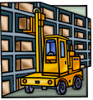



Goals to Components, Concerns
7: Multiple concerns: functionality, security, performance, technology…
2: Goal - Factories supplied just in time from supplier warehouses
Functionality
Security
Performance
Technology
…
1: Problem Domain – factories, supplies, warehouses, partners, existing systems
3: Refinement to sub-goals on sub-domains
3b: predict production load, optimize supply schedule
3c: make deliveries
3a: track inventories
4: Scope of sub-goals get narrower.
Some assigned to components.
Factory Supply Optimizer
production load predictions
supply scheduling
supplier
inventory
deliveries
scheduling
predictions
5: Applications, Components, Connectors
– specifications for each one
– end-to-end satisfaction of goals
6: Applicable to any granularity of goals and components

Slide 14
MAp Viewpoints
Information supports goals, process
Process supports goals
Domain / Biz
Architecture
1
Outside
Domain: Information, events
Goals
Process
Goals – success criteria
Black box assembly includes S,
Supports business model
Traceability
Mapped Black box Assembly (including S)
1
S
Component Architecture
Black box Spec (of S)
S
E
D
S
1
2
S: Information
Boundary
Architecture Styles: Principles, Patterns, Guidelines, Rules
Black-box Specification (of S)
4
S: Behavior
3
Black box view of S
Architecture styles, patterns: across viewpoints, projects
White box view of S
sub-component s1…s3
Partitions behavior & information
1
2
S
S
Component Architecture
White box design (of S)
s2
Inside
s2
s1
3b
s1
s3
3a
s3
4
Information
Behavior
Each sub-component could be drilled-down if needed

Slide 15
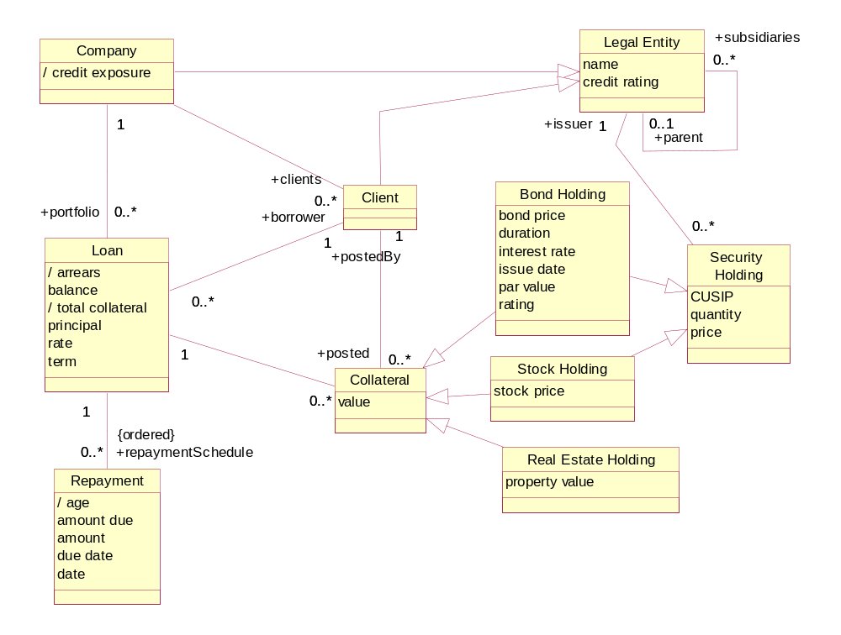
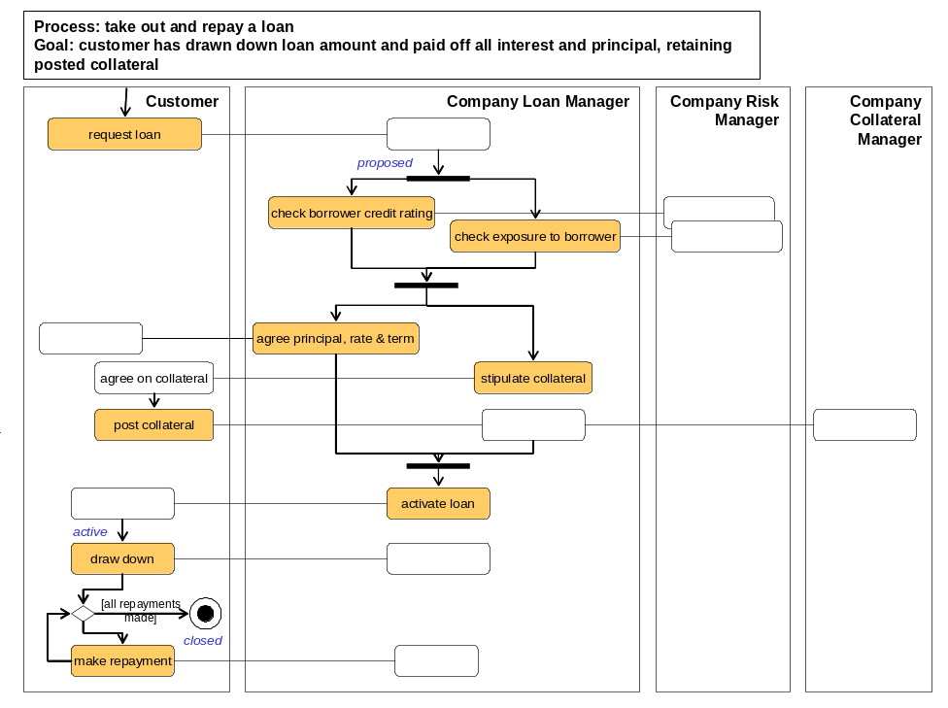
Loans Example – Goals, Domain Model, Biz Process Model
Goals clearly defined in domain terms.
Goals refined into adequate sub-goals
Subgoals checks: necessary? sufficient?
Minimize Credit Exposure Risk
Maximize Return
Predict Risk
….
Adjust Risk Exposure Factors
…..
Unambiguous definition of domain terms
  Object types, attributes, events
Terms defined in “drill-down” as needed
Track Risk Prediction History
Improve Predictive Model Over Time
Process activities clearly defined in domain terms
Business process demonstrably supports goals

Slide 16
Example – Black-box partition & mapping of Domain Model
Clear authoritative ownership of information by top-level components
Top level “black-box” components
Loans System
Reference Data System
Collateral Management
System
Explicit dependencies between information across components

Slide 17
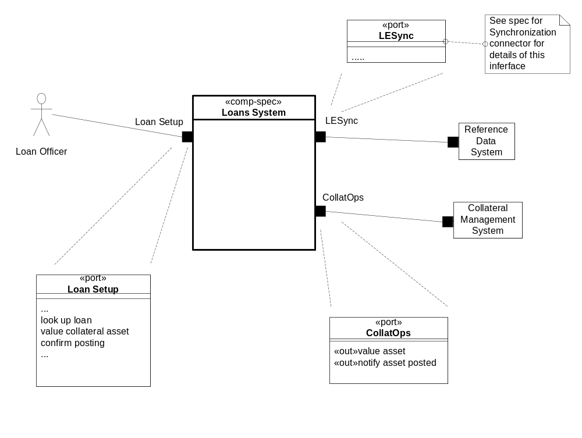
Example – Black Box Assembly
Ports  define connection points on components
Services provided and required explicit
Logical connections between components clear
Clear underlying information ownership
Loans System
Reference Data System
Collateral Management
System
Interfaces specified explicitly

Slide 18
Multiple Concerns, Styles, across Viewpoints
Functionality, security, location, technology … specified at suitable granularity and level
Module: build-time structure of software units including sources and tools
Location: deployment, location & connectivity: people, hardware, software
Technical: technical and platform realizations of components, ports, connectors
Concerns
Performance: throughput, response time, latency, data volumes, loads
Security: who can and cannot do what and to whom
Logical Functionality: what actions with what information and what triggers
1. Business Architecture
Business perspective on the problem or concern, including goals, activities, interactions, and information.
Outside
Architecture Styles: Principles, Patterns, Guidelines, Rules
Viewpoint
2. component architecture
– Black Box
Describe a large grained software component as a black box, with its behavior and information responsibility to others in its environment, for any aspect that is externally visible.
Boundary
3. component architecture
- White Box
Design the “insides” of a black box component as a collection of connected sub-components, each a black-box, and decide how they collaborate to fulfill black box responsibilities.
Inside
Address all relevant concerns early in the process and in the appropriate viewpoint
Notes:
REVISIONS:
Add summary of UML diagrams used.

Slide 19
Technical Architecture
– Complex “Overlay” on Components + Connectors at any Level
– 1st Class Connectors
White-Box: Logical Components and Connectors
A:1
A:2
C
C
A:3b
A:3a
A:4
Information
Behavior
Logical component has complex technical platform realization
Logical connector has complex technical platform realization
Technical platforms to run components and to communicate via connectors
Technical: Component
Technical: Connector
platforms,
configurations
thick client and db
VB to J2EE via messaging
White-Box: Technical Realization of Components and Connectors

Slide 20
Exercise – Discuss The Following Jointly
Need shared domain
vocabulary
Where would these fit in the formal MAp architecture framework:
A worker has a job and many roles, each requiring some system access
Entitlement to any resource is decided by a workers job, role, the corresponding systems’ access required
No worker should be able to access a resource unless entitled to that access
The Entitlement Review process finds inappropriate entitlements and fixes them
The ER component owns all current Entitlement information
The HR component owns all job and role-related information
The Provisioning and De-Provisioning component owns review rules
The ER component provides services to assist entitlement managers perform their entitlement reviews
The Provisioning and De-Provisioning component provides services to change entitlements
Entitlement change requests from ER to Provisioning and De-Provisioning are communicated using MQ-Series
The ER component is realized by a collaboration between a Review-Scheduler, Rules-Checker, and Violations-Handler components
Domain / Biz
Architecture
Need shared domain
vocabulary
Goal
1
Outside
sub-goal
sub-goal
Domain: Information
Goals
Biz.Process
Black-boxes use cases and info
models support business model
Black box Assembly (including S)
Component Architecture
Black box view (of S)
S
1
S
1
S
2
E
D
Boundary
S: Information / Attributes
4
Black-box Specification (of S)
S: Behavior
Architecture Styles: Principles, Patterns, Guidelines, Rules, Transforms
3
Black-box behavior and info model
partitioned into sub-components
S
1
S
2
Component Architecture
White box view (of S)
s1
s2
Inside
s1
s2
s3
3b
3a
s3
4
Information
Behavior
functionality
security
location
performance
technology

Slide 21
Outline
What is MAp?
Formal Architecture Framework
  Goal Modeling
  Viewpoints and Concerns – Black Box, White Box, Technical
  Architecture Style
Process Pragmatics
  Iterative and Incremental
  Roadmap Route: Problem Definition, Current State, Target State, Migration Plan
  Flexible Models and Domains
Summary

Slide 22
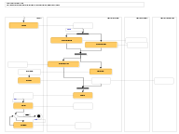
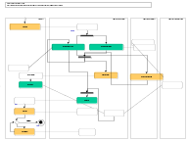
Architecture Principles and Styles
Architecture styles define rules of architecture conformance
Architecture styles define patterns of preferred or allowed architectures
One common form: Wherever you have … solve it by …
Very wide spectrum of styles in (and across) all viewpoints
  Business Process Style: Earliest point of data capture
    Wherever any process needs some information at multiple points …
    Capture the information at the first opportunity in process. Never require it again.
  Technical Architecture Style: MQ Series Configuration Style for Co-located Queues
    Wherever co-located components need a messaging connector …
    For a source S of events and a destination D that will be co-located on a single machine, use an MQ Series queue named <S><D><…>, configured as <….>, and set up the S and D ends of the queue as <….>
  Technical Architecture Style: XML encoding styles
    Use nested entities for …; use attributes for …; compress names as follows …
  Integration styles: point-to-point, desktop, gateway, …
Styles can be of more or less prescriptive and automated
  rules-of-thumb: if high availability is needed use replication and heartbeats
  review criteria: Component count should be constant or increase very slowly with increase of users
  fully automated transformations: generate EJB deployment descriptors, data model from source model
☑
☒
☑
☒

Slide 23
Structure of “Fully Dressed” MAP Deliverables
Styles, principles, and patterns
Business Architecture
  Goals model and Domain Info model
  Principles and styles
  Business process / subject area 1
    process model + information model
  Business / subject area 2
    …
  [ Cross business area spec ]
Component Black Box (of <X>)
  Styles, principles, and patterns
  Black Box Assembly and Map
  Black Box Spec of <X>
  Grouped by actor, port, subject, …
    Use case specifications
      Ins/Outs
      Pre and post conditions
      Main and alternate paths
      System operations
  Black-box information model
    Persistent state + input/output
  Security, performance, location, …
  API, UI, technology specifics
Component White Box (of <X>)
  Styles, principles, and patterns
  Assembly of sub-component C1, C2, … Cn
  For each major use case or system operation
    Collaboration between C1 … Cn
  Sub Component C1 – black box spec
    Information model
    Port 1 specification
      Operation specifications, in, out, pre, post
    Port 2 specification
      Operation specifications…
  Sub Component C2 – black box spec
Technical Architecture (black/white box level)
  Styles, principles, and patterns
  Connector realizations
    Shared connector styles – spec + realization
  Component realizations
    Language, platform, data base, protocols, etc.
Deployment Architecture
  Styles, principles, and patterns
  Location, node, network, platform configuration
  Software deployment on to network
X
B2
C1
C3
B1
C2
B3
Documents include narrative, rationale, examples, … in addition to models

Slide 24
Outline
What is MAp?
Formal Architecture Framework
  Goal Modeling
  Viewpoints and Concerns – Black Box, White Box, Technical
  Architecture Style
Process Pragmatics
  Iterative and Incremental
  Roadmap Route: Problem Definition, Current State, Target State, Migration Plan
  Flexible Models and Domains
Summary

Slide 25
Two Aspects of the MAP Framework
Formal Architecture Framework
Goals
Viewpoints
Concerns
Models
Refinement
Architecture Styles
Process Pragmatics
Routes: Roadmap, Construction, …
Different Entry Points
Iterative and Incremental
List, Draft, or Dressed Templates
Guidelines
Checklists
Architecture always ties back to goals.
Different presentation suitable to audience
Clear and unambiguous architecture
How to prioritize and focus work?
How much detail is appropriate and when?
How to show early value and reduce risk?
How to customize to project needs?

Slide 26
Outline
What is MAp?
Formal Architecture Framework
  Goal Modeling
  Viewpoints and Concerns – Black Box, White Box, Technical
  Architecture Style
Process Pragmatics
  Iterative and Incremental
  Roadmap Route: Problem Definition, Current State, Target State, Migration Plan
  Flexible Models and Domains
Summary

Slide 27

MAp can provide complementary value to an SDLC
MAp
Roles
SDLC
1
PM Submits
Request
1
Outside
QA
Approval
Domain: Information
Goals
Biz. Process
Yes
Task
Complete
Black box Assembly (including S)
No
S
1
S
1
S
Lifecycle Process
PM Accept
Task to be
Completed/
Corrected
E
D
2
Boundary
Yes
2
S: Information
Architecture Styles: Principles, Patterns, Guidelines, Rules
Black-box Specification (of S)
S: Behavior
3
4
No
PSA
Override
Task
Complete
Yes
S
1
S
2
No
s2
s1
s2
Inside
Task Must be
Completed/
Corrected
s1
s3
3a
3b
s3
Information
Behavior
4
Document Templates
3
Adapt MAp to the SDLC structure for the organization
Add specific useful tools within the SDLC
  How to frame the problem and clarify the domain terminology
  How to derive and validate key architecture decisions
Fill in key parts of templates e.g. Business Requirements, Functional Specs
  Model of goals and it’s refinement to architecture decisions
  Specification of services, components, connectors
Define relations and consistency criteria across descriptions

Slide 28
Architecture Viewpoint ≠ Development Sequence
Each deliverable base-lined, frozen
Time
Waterfall
1. Business Architecture | Business perspective on the problem, including activities, interactions, and business information.
2. Component Architecture – Black Box - White Box | Describes one (or more) large grained software components as a black box, with its relation with others in its environment, including its behavior and information responsibility.
 | Designs the “insides” of each black box software component as a collection of sub-components, specifies each one, and decides how they collaborate to fulfill black box responsibilities.
4. Technical Architecture | Designs the connectors between the components to support their designed interactions, the platforms to support the components, mapping both to technology.
5. Deployment Architecture | Designs the hardware structure (nodes, connections, devices, …) and which deployable software units will map onto the hardware to support component execution and communication.
6. Module Architecture | Designs the deployable compiled software units, and how they are generated from structured source units, that are in turn determined from the application and technical architecture.
Iterative
1. Business Architecture | Business perspective on the problem, including activities, interactions, and business information.
2. Component Architecture – Black Box - White Box | Describes one (or more) large grained software components as a black box, with its relation with others in its environment, including its behavior and information responsibility.
 | Designs the “insides” of each black box software component as a collection of sub-components, specifies each one, and decides how they collaborate to fulfill black box responsibilities.
4. Technical Architecture | Designs the connectors between the components to support their designed interactions, the platforms to support the components, mapping both to technology.
5. Deployment Architecture | Designs the hardware structure (nodes, connections, devices, …) and which deployable software units will map onto the hardware to support component execution and communication.
6. Module Architecture | Designs the deployable compiled software units, and how they are generated from structured source units, that are in turn determined from the application and technical architecture.
Time
Same deliverable refined across iterations
Development often should not be waterfall i.e. not 1-viewpoint at a time
Each iteration can cover multiple viewpoints
Same deliverables is refined across iterations
Same models can be presented as tables, bullet lists, formal diagrams
Flexible form with consistent content

Slide 29
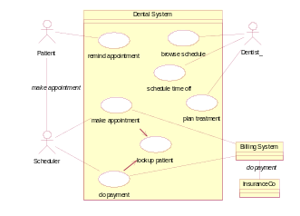
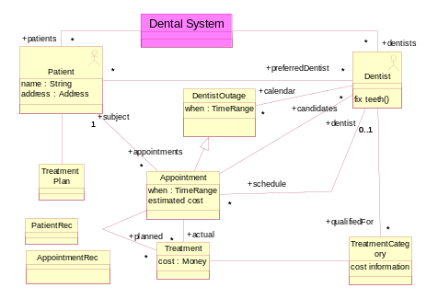
List, Draft, and Dressed Versions
_{Fully Dressed Version}
Spec
1. Business Architecture | Business perspective on the problem, including activities, interactions, and business information.
2. Component Architecture – Black Box - White Box | Describes one (or more) large grained software components as a black box, with its relation with others in its environment, including its behavior and information responsibility.
 | Designs the “insides” of each black box software component as a collection of sub-components, specifies each one, and decides how they collaborate to fulfill black box responsibilities.
4. Technical Architecture | Designs the connectors between the components to support their designed interactions, the platforms to support the components, mapping both to technology.
5. Deployment Architecture | Designs the hardware structure (nodes, connections, devices, …) and which deployable software units will map onto the hardware to support component execution and communication.
6. Module Architecture | Designs the deployable compiled software units, and how they are generated from structured source units, that are in turn determined from the application and technical architecture.
Use case: make appointment
Actors: Scheduler, System, Billing System
Inputs: patient info, date, symptoms (from Scheduler)
insurance info (from Billing System)
Outputs: appointment info, cost, dentist (to Scheduler)
Trigger: Patient calls for appointment
Precondition: None
Postcondition: An appointment has been created for
patient with suitable dentist for date, to
cover planned treatments. Insurance and
cost estimates recorded.
_{Black}
_{box}
Use
Cases
_{List Version}
Use cases Enquire about product Place order
Terminology Customer need Product
Main (success) steps:
Patient calls Scheduler for appointment
Scheduler looks up patient with System
Scheduler enters symptoms and date
System queries insurance info from Billing System
System estimates patient cost
System provides appointment, plan, staff, insurance, cost
Scheduler discusses with patient and confirms
Alternate paths:
2. Patient not found: …
Design
use case: lookup patient
Actors: Scheduler, System
…
action: estimate patient cost
post: …
_{Draft Version}
Info
Model
Actors | Customer, Sales Agent
Use cases | Enquire about product: Goal: The system has recorded customer’s need for product. Callback has been scheduled, cross-sell analysis initiated.
 | Place Order: ….
Glossary | Customer: a legal entity who … need: the set of likely future purchases Product: A unit of sales to customer …
Depth, detail, and form to suit context
Don’t produce fully dressed all at once
Iterative MAP
Iterations within phases
Inception
Elaboration
Construction
Transition
List:
Goals
Domain
List:
Black box
White box
Initial system:
List:
technical
Release

Slide 30
Outline
What is MAp?
Formal Architecture Framework
  Goal Modeling
  Viewpoints and Concerns – Black Box, White Box, Technical
  Architecture Style
Process Pragmatics
  Iterative and Incremental
  Roadmap Route: Problem Definition, Current State, Target State, Migration Plan
  Flexible Models and Domains
Summary

Slide 31
Different Project “Routes”
Business, Black box, White box, Technical, … Architectures
  For a project, which deliverables developed when and how far?
Greenfield
Package
Roadmap…
Different projects, different “routes”
  Different paths through deliverables
_{Business}
Different architecture styles
  … applicable for different projects
_{Black}
_{Box}
Light-weight
black-box
as you don’t know
package capability
Current State
_{White}
_{Box}
Target State
Styles
What do I have?
_{Technical}
Glue together

Slide 32
Roadmap
Route
Initial issues, objectives, stakeholders, etc.
buried business knowledge
refine goals and obstacles
for target state work
Frame the Problem: formalize problem, syndicate with stakeholders
Goals model Key domain terms
known reference architectures,
best practices, etc.
top-level problem definition,
domain terms to map,
priorities, focus areas
Analyze The Current State
Define The Target State
Business architecture
scenarios and process sketches
key information terms
problems and opportunities
Business architecture
principles and styles
processes, roles, activities
validation vs. goals and obstacles
problems and opportunities
Component architecture:
principles and styles
[black-box] top-level assembly
[black-box] context: ports, use cases
[white-box] sub-component assembly
[white-box] end-to-end collaborations
technical properties, mapping styles
validation vs. goals and obstacles
target reference architecture
e.g. components, functions,
information … for inventory
Component architecture
application inventory and map
(against domain, target reference)
non-functional and technical props
problems and opportunities
Plan The Migration
relationship to other roadmaps and projects
goals, constraints, architectural sequencing dependencies
migration principles, stages: evolving architecture snapshot with gaps, cost
cross-project
“program” conformance
project funding
project requirements
project funding
project requirements
project funding
project requirements

Slide 33

Road Maps and Migration Planning
MAP can describe architectures at a variable level of precision
MAP viewpoints apply to architecture migration plan
Stage Name | Current State | Interim 1 | Interim 2 | Target State
Stage Date | Feb 2002 | Nov 2002 | Sep 2003
Stage Description | … | … | … | … including Target architecture style
Logical Assembly Connected components, optional key interactions, business processes
Technical Architecture
Changes, Gaps, Training required
Costs, benefits, risks, rationale
Conformance to Target state architecture style

Slide 34
MAP “Construction” Route
Terminology of the domain
Business goals with “why”, “how”
Goals
Info Model
Technical architecture (parallel with use cases, white box)
Information relevant to system for use cases
Customized method “route”
Architect / implement
black box tech arch:
external connectors running
Use Cases
Information
Model
Use Cases
Units of interaction with the target system that help meet goal of actor
Tech Arch
Styles
Arch Styles
(Tech)
Component
Collaborations
Component
Specs
Arch
Styles
Architect / implement white box tech arch
Arch Styles
(Func)
Component
Collaborations
Component Specs
Component
Assembly
Partitioned
Info Model
Test end-to-end
technical architecture
Sub-component partition and end-to-end interactions
Component
Implementations
M
A
X
Component
Implementations
U
mutually
consistent
B
C
Y
D

Slide 35
Outline
What is MAp?
Formal Architecture Framework
  Goal Modeling
  Viewpoints and Concerns – Black Box, White Box, Technical
  Architecture Style
Process Pragmatics
  Iterative and Incremental
  Roadmap Route: Problem Definition, Current State, Target State, Migration Plan
  Flexible Models and Domains
Summary

Slide 36
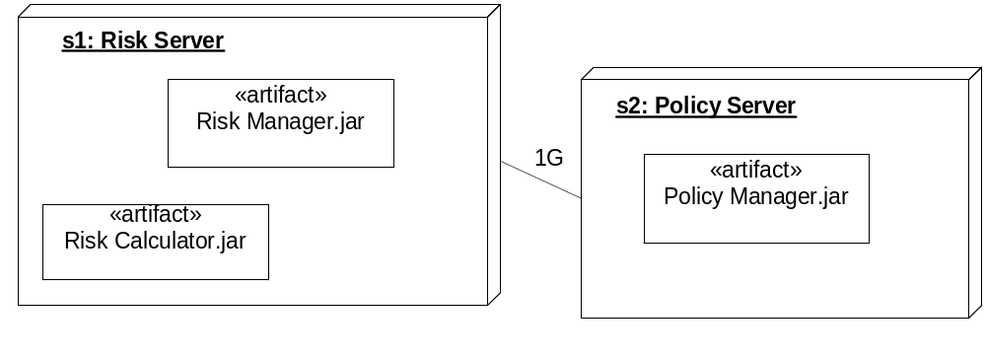
What is a Model?
Nodes
s1: Risk Server
s2: Policy Server
Artifacts
Risk Manager.jar s1
Risk Calculator.jar s1
Policy Manager.jar s2
Links
s1:s2 1G
Model: A structured description of selected properties of a domain or system, using some combination of textual or graphical formal language with informal natural language
Model ≠ Picture
  Structured text, tabular presentations very common and very useful
There can be more than one useful notation for the same abstract language
  Nodes have
    artifacts deployed on them
    communication links with bandwidth

Slide 37
Technical Domains and Business Domains
Domain is about Messaging
Domain is about Trading
Messaging
Business
Black Box
White Box
Terms: Message
Topic
Subscription
Queue
…
Interfaces: …
Trading security goals use Security domain model
Trading::Security
Trading::Func
Business
Black Box
White Box
- technical
Business
Black Box
White Box
- technical
Terms: Trade
Counterparty
Stock
…
Interfaces: ….
Security
Domain is about security
Business
Black Box
White Box
Terms: Role
Permission
Capability
Credential
…
Interfaces: ….
Trading white-boxes use Security interfaces
Infrastructure or technical domains (e.g. Security, Messaging) have their own business (or “domain”), including goals, black box, and white box models
These can be developed, to some extent, in parallel with the primary business domain (e.g. Trading)
When Trading is defined in technical or platform terms (e.g. white-box/technical(, that platform is defined by the technical domains

Slide 38
MAP is … MAP is not …
A consistent method to define and evolve architectures that can be used in many areas
An approach to clarifying goals and partitioning and connecting components and applications
Useful when used formally, on whiteboards, or just for clearer thinking: consistent content, flexible form
A toolkit for architects, business analysts, and designers to use to clarify and improve their designs
A way to clearly specify components for outsourced development
A framework within which to develop and promote shared architecture principles and standards
Just about technical details
  It addresses high-level technology-independent goals and architecture as well
A PDLC (Project Lifecycle)
  It prefers an iterative lifecycle, and adds architecture focus and concrete deliverables and techniques to a PDLC/SDLC
Only applicable to business systems
  It is also applicable to architecting technical and infrastructure domains

Slide 39
Migrating to MAP
MAP can be applied as rigorously or lightly as appropriate
The underlying concepts of MAP are few and simple
Simple ≠ Easy
Applying it effectively takes a focused and disciplined mindset
Classic migration path …
Unconscious Ease
Having an easy time without conscious effort
Conscious Ease
Having an easier time with conscious effort
Conscious Difficulty
Having a hard time and do know it
Unconscious Difficulty
Having a hard time and don’t know it

Slide 40
Summary and Discussion
Model-driven approach to domain and business-aligned architecture
Address both business and technical concerns
Clear separation of viewpoints for simpler architectural descriptions
Different entry points and routes applicable to different projects
Can be used to differing degrees of completeness and rigor as needed

